Slide 1





Annual report of national association of Taekwon-Do ITF 2014
Czech National Taekwon-Do Union ITF
www.taekwondocz.com NA for ITF & AETF in Czech Republic

Slide 2
Abouts
Czech National Taekwon-Do Union ITF
Varhulíkové 1582/24
Prague 7 ZIP 17000 Czech Republic
Company nr.: 26635861
Tax ID: CZ26635861
Registration: L 13917 Městský soud Praha
cnut@taekwondocz.com
www.taekwondocz.com
Czech National Taekwon-Do Union (CzNTU) was found in 2003, it is regular member of AETF and ITF.
CzNTU consists of 4 self-governing schools with 6 clubs in total.
CzNTU has 2 international instructors authorized to hold gradings.
Further it has 5 instructors with 2nd level of national trainer licence and 10 assistants with 3rd level of national trainer licence. Its activity is focused mainly to children and teen-agers. Mainly we organize summer camp (once a year), seminars, weekend activities like training camps, regional competitions, Czech Championship and other activities. To read more about our activities, please see our website.
www.taekwondocz.com
You Tube
Facebook
Google+
and websites of our member schools.
www.taekwondocz.com NA for ITF & AETF in Czech Republic

Slide 3
Organization structure
Czech National Taekwon-Do Union ITF Board of directors was elected at regular session of general meeting at 2013.
Board of directors:
President CzNTU - ITF:
Viktor Stein, International instructor IV. Degree
Contact:
tel: +420606551139
e-mail: president@taekwondocz.com
Secretary CzNTU - ITF:
Mrs. Monika Dobíhalová
Contact:
tel: +420733690075
e-mail: secretary@taekwondocz.com
Chairman of Technical committee CzNTU - ITF:
Ing. Kamil Kolofík, International instructor IV. Degree
Contact:
tel: +420732759451
e-mail: technical@taekwondocz.com
Member of the management:
Assistant of Technical committee CzNTU - ITF:
Mr. Robert Pokorný
Contact:
tel: +420603472117
e-mail: technical@taekwondocz.com
www.taekwondocz.com NA for ITF & AETF in Czech Republic

Slide 4
January - 2014
Plaques and fees 2014, annual report was presented
In January 2014, member fees for Czech Republic´s NA Czech National Taekwon-Do Union were paid- 50 € for ITF, 100 € AETF.
The annual report of the year 2013 was done. This has been authorized by Board of Directors of CzNTU and sent to ITF and AETF Headquarters.
All CzNTU´s trainers are holders of ITF Plaques
ID | First Last Name | Plaque number
481424 | Lenka Kolofíková | 607664
481430 | Kamil Kolofík | 197
481444 | Tomáš Mácha | 607654
481472 | Viktor Stein | 600979
481480 | Jaroslav Urbánek | 600981
481434 | Hana Kuprová | 600196
481705 | Petra Bláhová | 607663
503182 | Jan Růžička | 607655
503183 | Ondřej Růžička | 607656
503184 | Michal Zemanec | 607657
503185 | Jiří Holan | 607652
481436 | Pavel Kupr | 608036
481435 | Josef Kubát | 607653
www.taekwondocz.com NA for ITF & AETF in Czech Republic

Slide 5
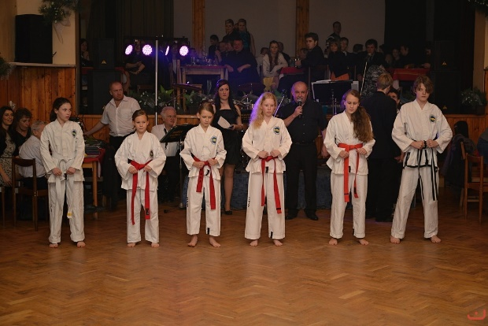
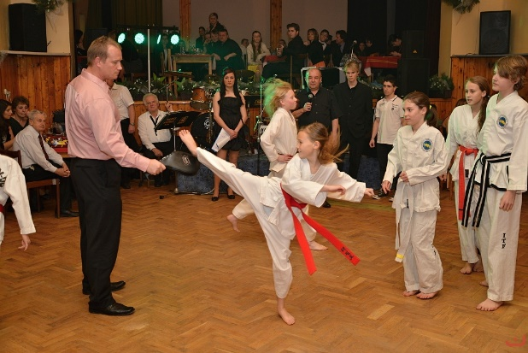
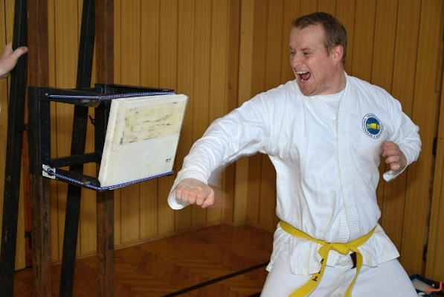
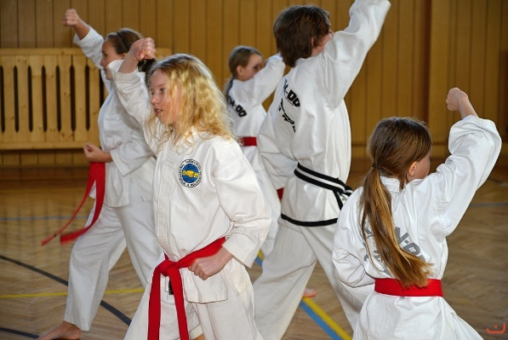
February - 2014
Demoteam – graduate´s ball Mnichovice
The CzNTU´s Demoteam started season of demonstrations at the Graduate´s ball of Secondary school of Handicrafts Kunice.
During the demonstration onlookers could see all components of Taekwon-Do – selfdefence, basic techniques, tulls, sparrings, special techniques as well as power breaking.
Regional seminar Čerčany
At the start of February, regional seminar was held. It was focused to the upcoming season of competitions, especially to the Prešov Open in Slovakia. The team of competitors under trainers supervision improved above all tulls and power breaking.
www.taekwondocz.com NA for ITF & AETF in Czech Republic

Slide 6
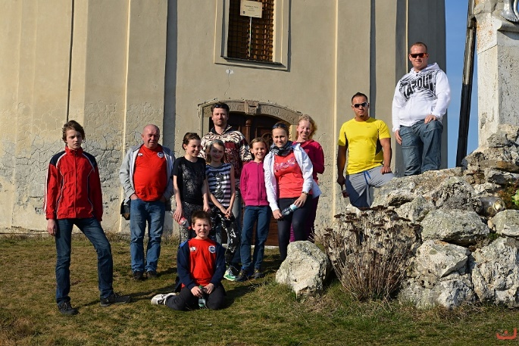
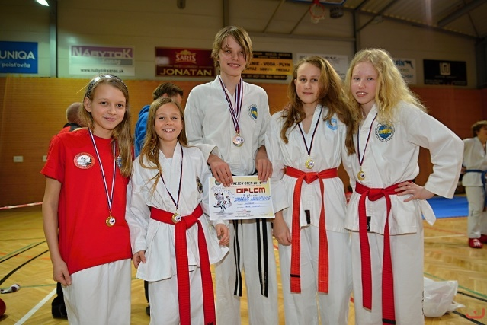
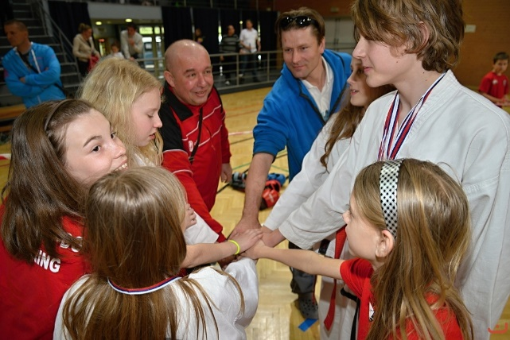
March - 2014
Prešov open - Slovakia - Sabinov
On 22nd – 23rd March 2014 the 12th Prešov Open, the international competition, was realized in Slovak city Sabinov. The competitors form Slovakia, Slovenia, Romania, Bulgaria, Belarus, Hungary and also Czech Republic were participated.
From CzNTU were participated childrens and Juniors from national preparatory team – Jakub Roubal (I. Dan), Sára Podskalníková 1st Kup, Lucie Bohatá 1st Kup, Natálie Podskalníková 2nd Kup, Patricie Pokorná 2nd Kup, Jiří Beneš 4th Kup a Eliška Hupcejová 9th Kup. We had also competitors in Seniors cathegories - Luboš Gašpárek, Vladimír Michal and Miroslav Štrba. The leader of Team was trainer, president of CzNTU, International Instructor Viktor Stein IV. Dan and the medial support was Mr. Robert Pokorný.
www.taekwondocz.com NA for ITF & AETF in Czech Republic

Slide 7
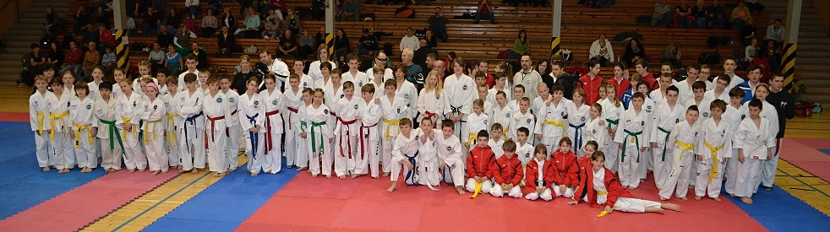
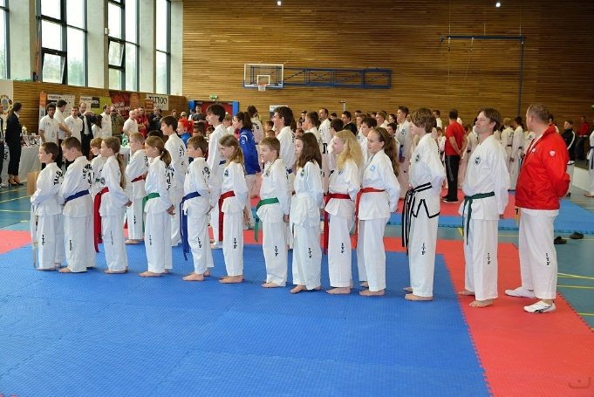
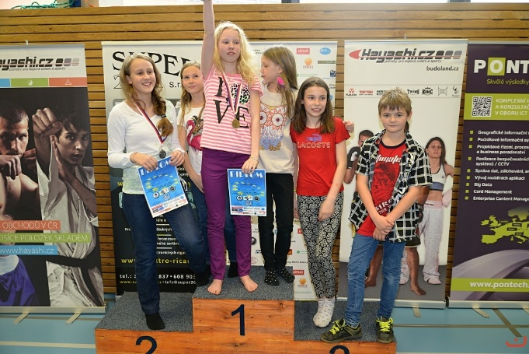
March - 2014
Budweis Grand Prix - České Budějovice
In March the CzNTU´s competitive team was participated in the competition in České Budějovice. The competition was succesfull for our team – they brought 4 medalls.
Best of Best - Říčany
In March the CzNTU´s competitive team participated in the competition in Říčany named Best of Best. Again competitors brought a number of medalls and they showed their quality. We are rightly proud of them.
www.taekwondocz.com NA for ITF & AETF in Czech Republic

Slide 8
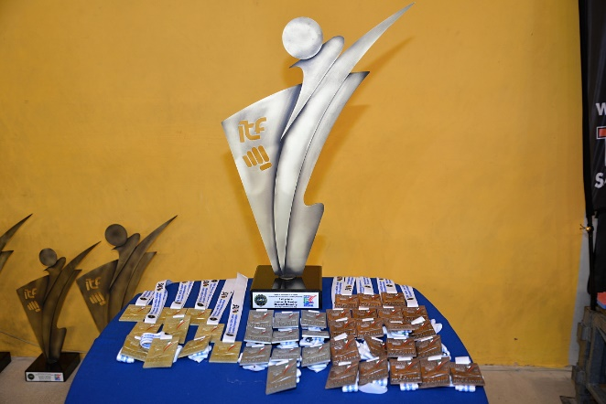
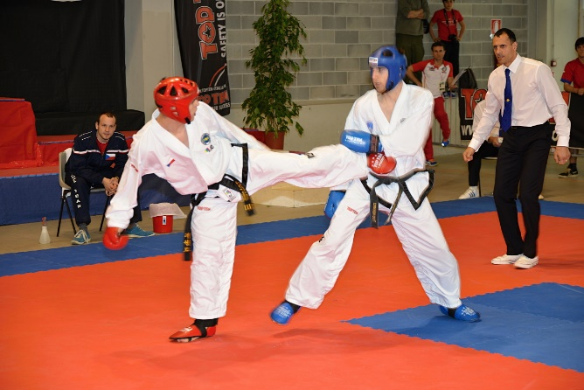
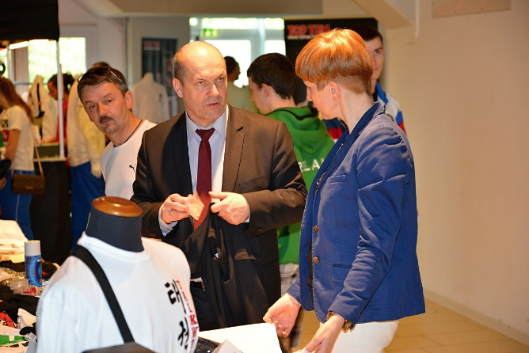
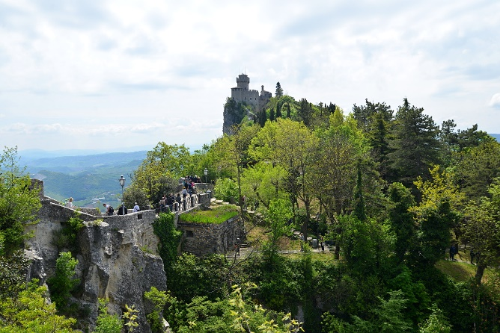
April - 2014
Participation at EC and AETF congress – Riccione Italy
The CzNTU´s delegation leaded by the President of CzNTU Viktor Stein and the Chairman of technical committee Kamil Kolofík visited the European Championship in Riccione, Italy. At the evening they took part in the AETF congress.
Following day, several personal meetings with AETF and ITF representatives were passed. Preparation of some events in Czech Republic was discussed during these meetings and CzNTU´s management was presented to representatives of ITF. After the end of championship we enjoyed the visit of the state San Marino.
www.taekwondocz.com NA for ITF & AETF in Czech Republic

Slide 9
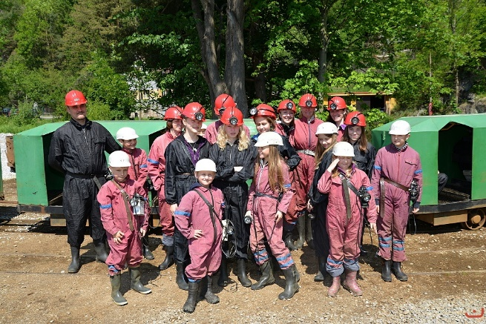
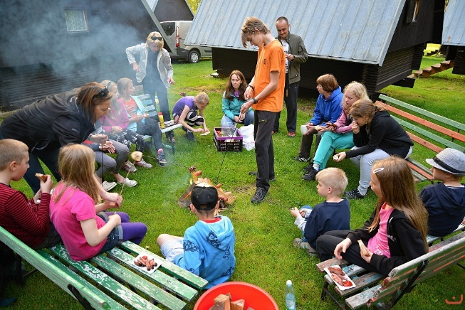
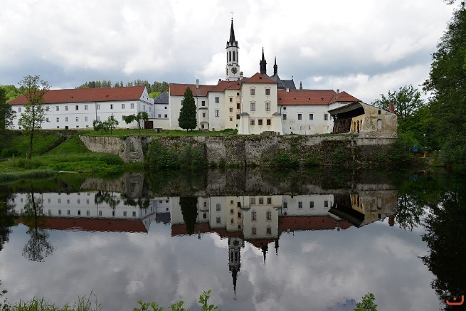
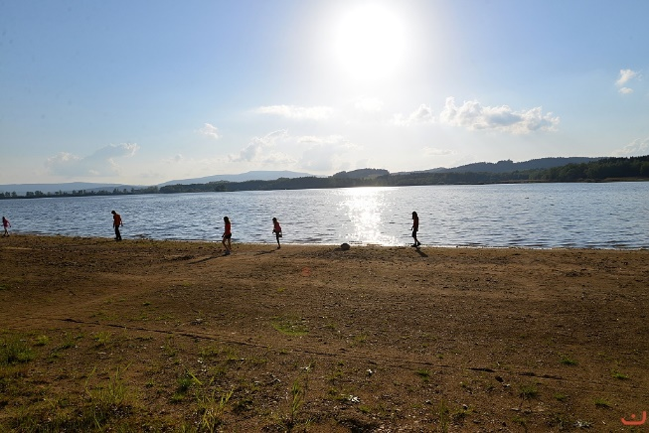
May - 2014
Dalyon – spring tour - Lipno
This time, students of Taekwon-Do set out to the South Bohemia region, to the Lipno dam and to the historic city Český Krumlov. We have visited the Lipno dam, rock structure named Čertova stěna (Devil´s wall) and ruins of castle Vítkův hrádek. On Sunday we have visited Český Krumlov where we took a look at graphite mine, historic centre of the city and castle park with theatre. We have had lunch in restaurant of Eggenberg brewery and during afternoon some icecreame.
Free time was intended for active rest at playground, swings and for a walk nearby the reservoir.
And naturally we have had also some training of selfdefence in pleasant area of Olšina camp near Lipno dam.
www.taekwondocz.com NA for ITF & AETF in Czech Republic

Slide 10
June - 2014
Meeting CzNTU - Říčany
This meeting was held in hotel Pavilon in Říčany, representatives of all schools and clubs were met there.
In the programm was besides other things authorization of financial plan and budget for the next season 2014/2015. The ending season 2013/2014 was evaluated.
The strategy of recruitment new students and presentation of Taekwon-Do during the summer demonstration of CzNTU´s Demoteam was debated.
The most important item of this meeting was organization of Summer camp in Podolí near Písek city in South Bohemia.
www.taekwondocz.com NA for ITF & AETF in Czech Republic

Slide 11
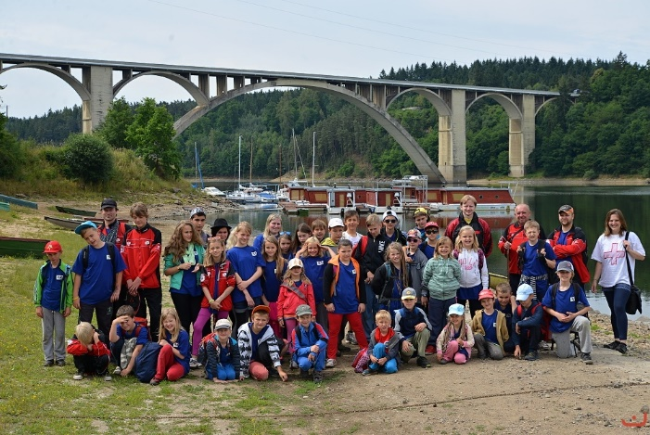
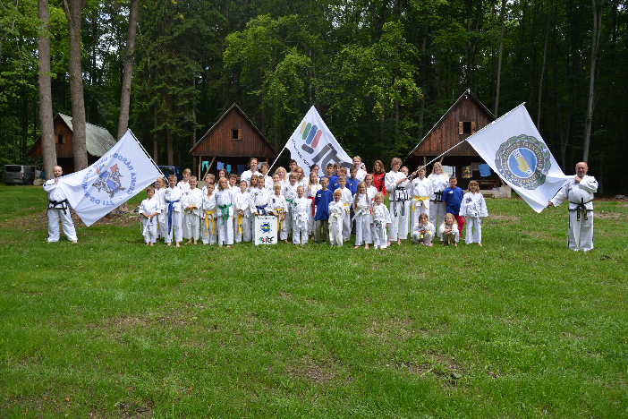
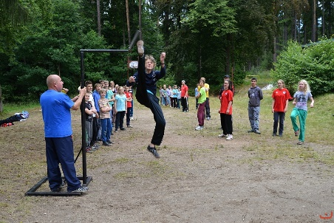
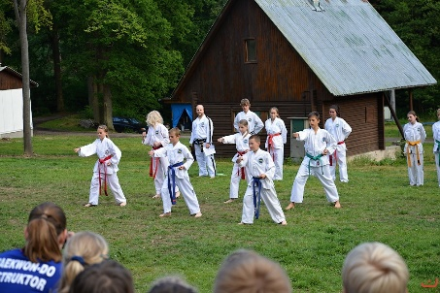
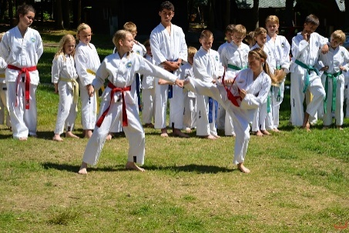
July - 2014
Summer camp 2014
In the Czech Republic, close to the town Písek, is held this week (from 28th June to 5th July) another Summer Camp of Czech National Taekwondo Union´s clubs. Not only the members of our clubs are participating on this year´s camp. Also we have a few children who do not practice Taekwon-Do but they are interested in self-defence.
The event is held in the area of „Tábory OKO“, where we can find many playgrounds (volleyball, basketball, football etc.), pond, swimming-pool and clubroom in case of rainy weather.
Also this year we have prepared for participants very rich programm – technical and sports trainings, comptetions, night game, camp fires, paitball, Kup-gradings, exhibitions (for participants from other camps in our area) and within the framework of Dallyon wholeday trip to the Orlik dam. On top of, our Internatinal instructors have prepared for participants some special trainings.
www.taekwondocz.com NA for ITF & AETF in Czech Republic

Slide 12
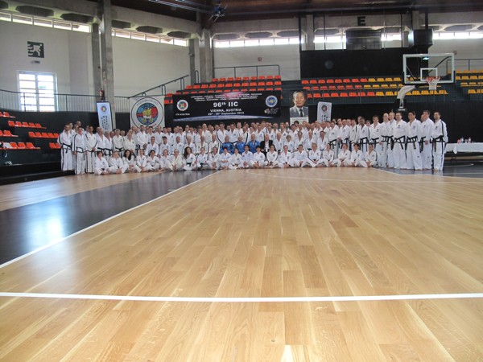
September - 2014
Attend at 96th IIC - Vienna
13 black belts from Czech Republic attended 96th IIC in Vienna, Austria.
The whole weekend was a very well organized. From trainings in nice hall to great programme during the banquet. We spent 16 hours in gym – it was well spent time with icons of Taekwon-Do GM Willem Jacob Bos, GM Hector Marano and GM Kim Ung Lan. Very beneficial was also
a presentation of childrens programme ITF Kids by Master Donato Nardizzi VIII. Dan.
This seminar was a huge experience and motivation for our next trainings, personal developement and trainers practice.
www.taekwondocz.com NA for ITF & AETF in Czech Republic

Slide 13
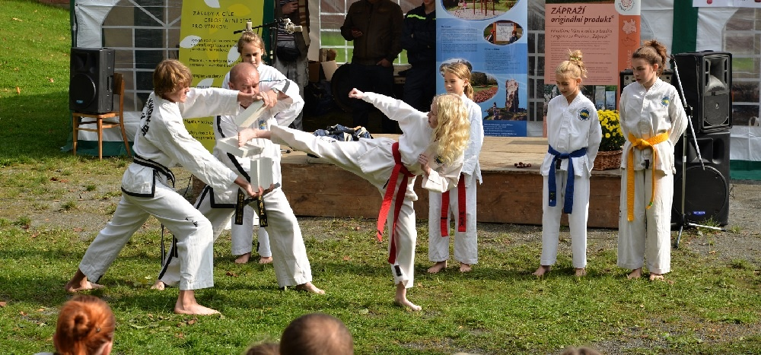
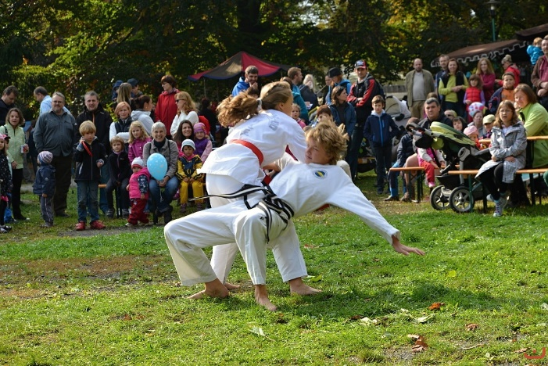
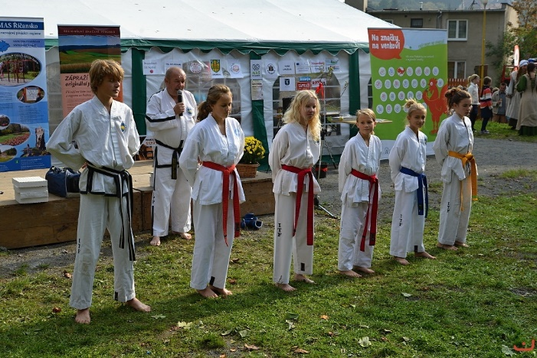
October - 2014
Demonstration – Apple festivities Strančice
On Saturday 4th October our Demo-team participated at Festival of Handicrafts and Apple festivities in Strančice.
Members of Demo-team: Jakub Roubal (I. Dan), Lucie Bohatá, Sára Podskalníková, Natálie Podskalníková (all 1st kup), Daniela Richterová (4th kup) and Eliška Hupcejová (7th kup).
Lot of thanks to member of our Demo-team for their great performance to promote Taekwon-Do. We also thanks organizers for invitation to this interesting event and we are looking forward to cooperation in next years.
www.taekwondocz.com NA for ITF & AETF in Czech Republic

Slide 14
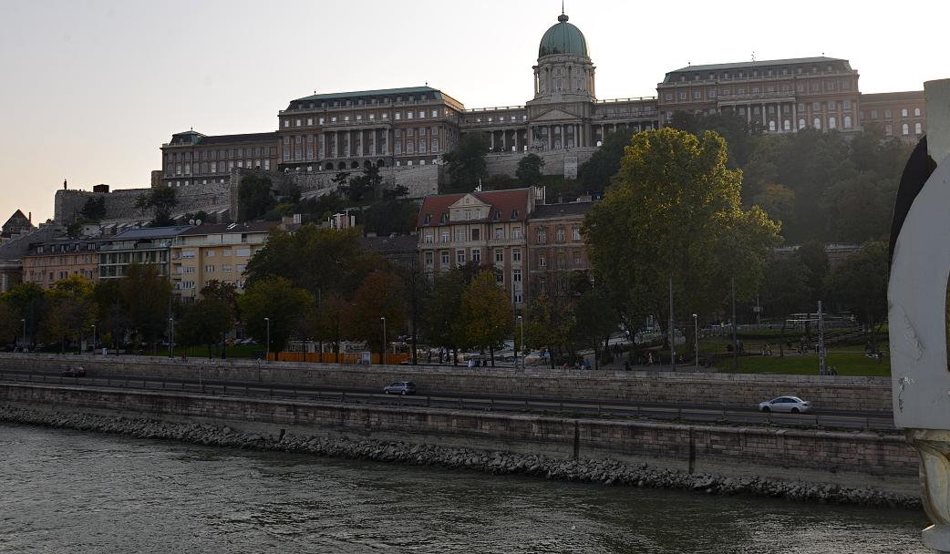
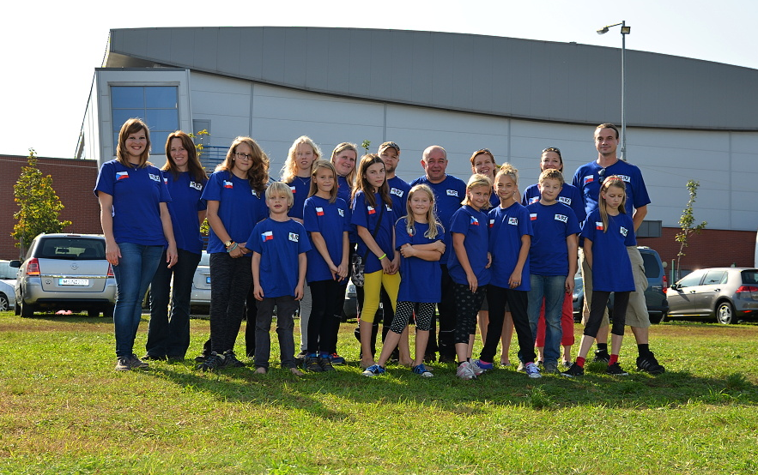
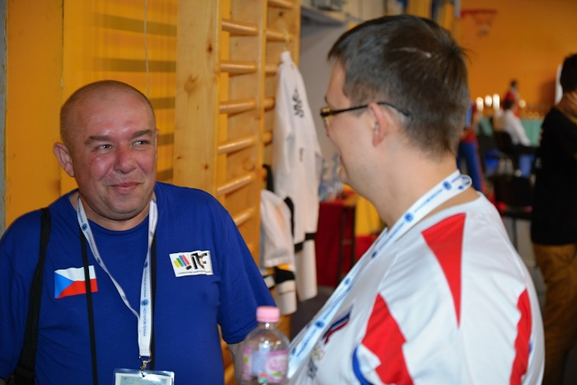
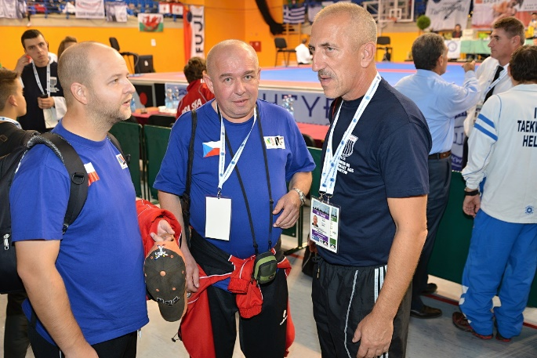
October - 2014
Attend at European Cup - Budapest
During the weekend 10th – 12th October 2014 the European Cup of Taekwon-do was held in the capital of Hungary, Budapest. Group of young competitors and members of CzNTU´s National team preparatory visit this event. Leaders of this expedition were Mr. Viktor Stein (IV. Dan) - president of czech NA CzNTU, Mr. Kamil Kolofík (IV. Dan) – chairman of Technical committee and medial support Mr. Robert Pokorný. Our competitors wanted to visit big European competition to see how it works and to do good preparation for their own participation in some event of this type. We trust their motivation to participate in international competition rose up.
www.taekwondocz.com NA for ITF & AETF in Czech Republic

Slide 15
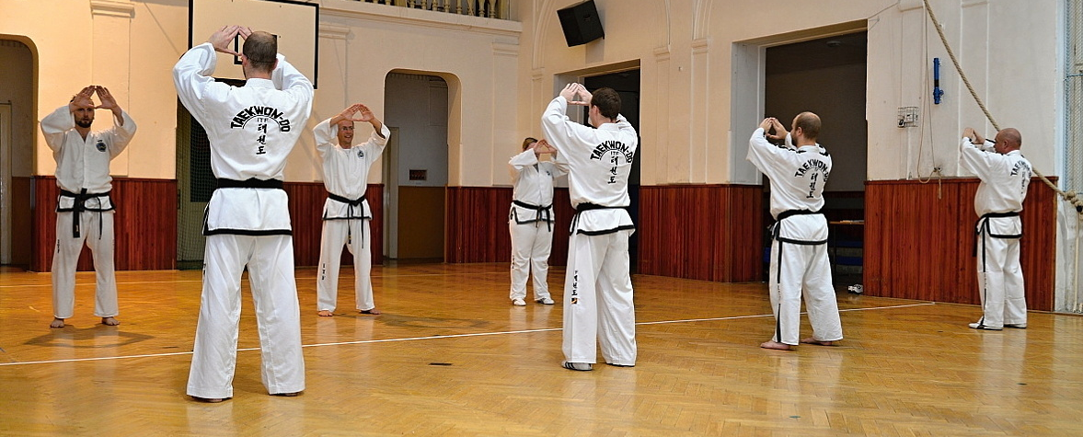
November - 2014
Seminar for lower colour belts - Čerčany
Seminar under leading of International Instructor Kamil Kolofík, IV. Dan, was determined for lower colour belts – Kup.
Participants were informed about course of competitions, terminology of referees and way of marking in all cathegories (tulls, sparrings, special techniques, power breaking, pre-aranged sparring). Students could try the work of referees and scorekeepers. All seminar was lead in fun way and all participants enyoed it.
Training for trainers - Benátky nad Jizerou
Training for trainers was focused to a preparation to national seminar and to grading which held in December 2014, tulls to 5th Dan were practised.
www.taekwondocz.com NA for ITF & AETF in Czech Republic

Slide 16
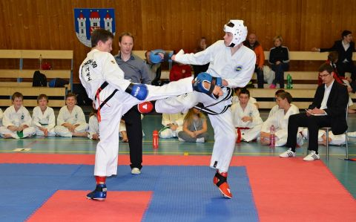
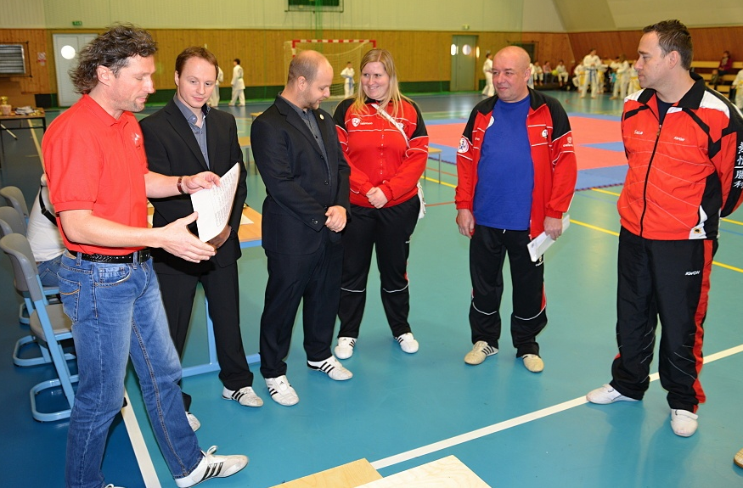
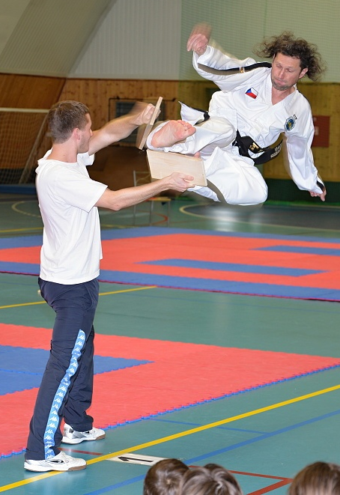
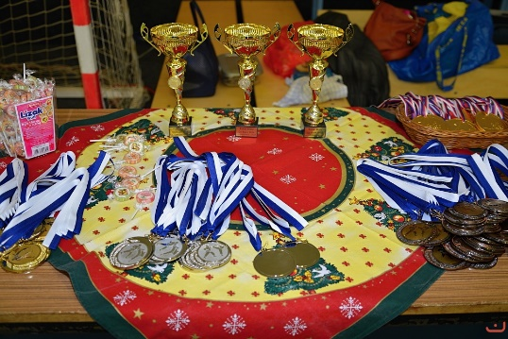
December - 2014
Cup of the Taekwon-Do school Ge-Baek
The tournament was held in awesome sporthall in Bělá pod Bezdězem on 13th December 2014.
The tournament had very high level of quality of competitors and of organization too. Our competitors did not have anything for free. After hard contests they earned three gold, four silver and nine bronze medals.
Before the start of afternoon part of competition, some students of Ge-Baek Taekwon-Do school together with their instructor showed exhibition which was consisted of very nice and real selfdefence and all of the usual parts of competition – tulls, sparrings, special techniques, power test and pre-arangend sparrings.
We would like to thank organizatiors for invitation to very nice event and for an awesome day spent with Taekwon-Do.
Attendance at Cup of the Taekwon-Do school Ge-Baek Mladá Boleslav
www.taekwondocz.com NA for ITF & AETF in Czech Republic

Slide 17

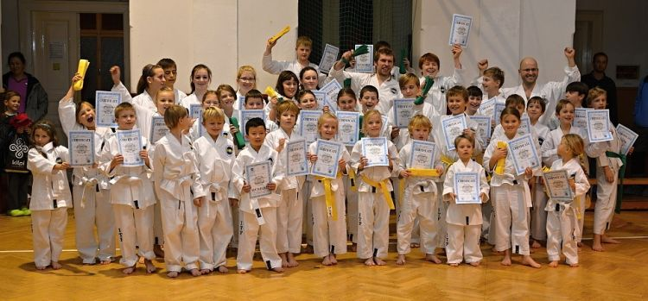
December - 2014
Kup grading in CzNTU
At the end of year 2014, International Instructors of CzNTU were in hurry to do KUP grading in schools and clubs of CzNTU.
After a period when students were hardworking on their Taekwon-Do knowledge and skills, almost one hundred of students asked the Technical commitee of CzNTU (via their trainers) for grading.
The grading was on high quality level. This is the sign of their high-standard preparation. As well it is a certificate for their teachers and trainers, who did great work during preparation of new young generation.
Our biggest reward was a joy in childrens faces, when they showed their new certificates and new colour belts to their parents and brothers – they were very pride on it.
Next grading is scheduled at the end of season – June 2015.
www.taekwondocz.com NA for ITF & AETF in Czech Republic

Slide 18
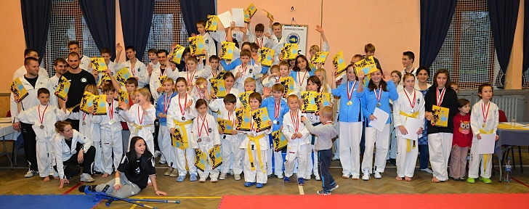
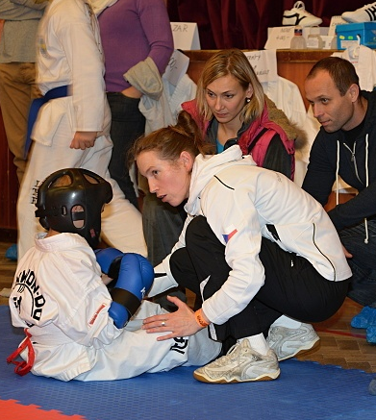
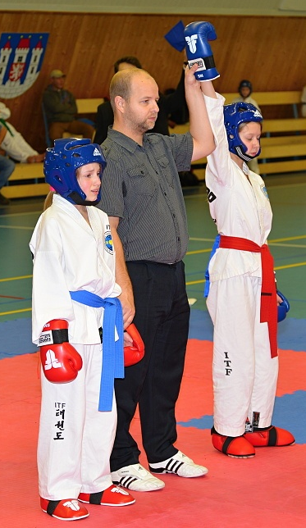
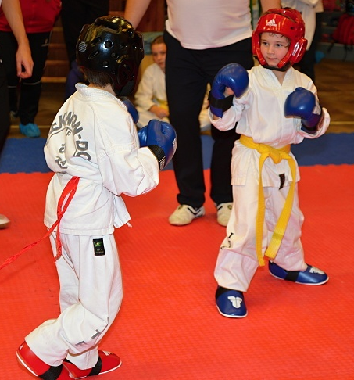
December - 2014
New project of CzNTU
Competitions for competitors-beginners
In November and December 2014 were held some competitions for competitors-beginners. While older experienced competitors collect medalls and experiences in national competitions, young and beginners are sometiones afraid of entering to tatami and do sparrings. It is nothing strange that parents are more afraid then young competitors and they do not want to allowed children to participate on competitions. In Czech Republic 70 % of students do not participate on competitions. To solve this situation CzNTU ran a new project, which should help to introduce these children and parents to the world of competitions.
Within this project, we would like to held some competitions, where children and parents will be informed about rules of sparring and they will see practical demonstration of real competition course. We hope that we get many new competitors.
www.taekwondocz.com NA for ITF & AETF in Czech Republic

Slide 19
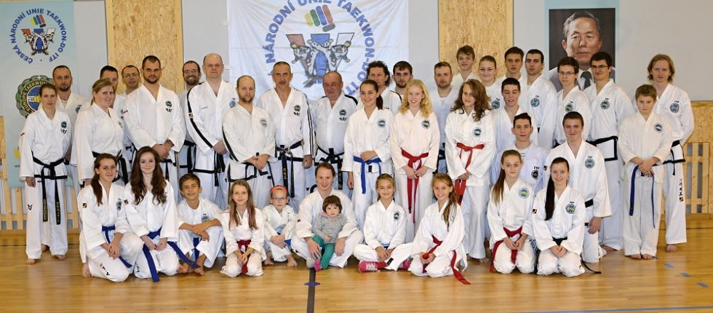
Prosinec - 2014
National seminar 2014
On the 20th of December 2014, in a small Central Bohemian town Strančice (near capital Prague), there was organized a national seminar ČNUT led by the world legend - master Jerzy Jedut, VII. Dan (general secretary, a member of AETF Technical committee and coach of the Polish national team).
A great place for this event was kindly provided by local elementary school Strančice, that’s why we would like to thank this way to Mgr.Kateřina Schejbalová, school director and other supporters for their help during the day and well prepared training hall.
Our thanks belongs also to the partner of this event – company Hayashi, representing the TOP TEN brand in Czech Republic and delivering also other martial art and self-defense products.
A huge appreciation belongs also to Berchtold castle management,that helped with accommodation for our guest and provided a great conference hall for follow up meetings, incl. refreshment.
The seminar hosted in total 40 participants (particularly trainers) from the Czech National Union of Taekwon-Do and Czech Taekwon-Do Association. However, attended also Taekwon-Do schools Tong-Il České Budějovice, Sonkal Prague, Ge-Baek Mladá Boleslav, Strančice, Benátky nad Jizerou, Příbram, Sparring Kunice, Velké Popovice and Čerčany.
The seminar began with a short intro, followed by non-traditional heating and stretching exercises, immediately catching all participating trainers.
After a proper heating, the rest of the morning was devoted to patterns from Chon-Ji to Choong-Moo, together with basic techniques from these tulls.
www.taekwondocz.com NA for ITF & AETF in Czech Republic

Slide 20
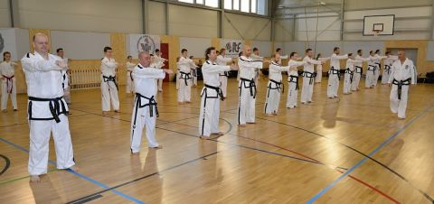
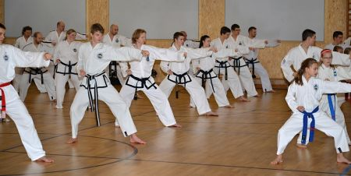
December - 2014
National seminar 2014
The afternoon part of the day started with several games for body heating again, followed by less conventional practices of sport techniques and then continued the technical block of patterns for two separated groups of colorful and black belts. At the end of the seminar there were shortly refreshed possible ways of turnings and overall stepping.
At the end of the valuable day Master Jedut received a present – small plush toy “Moll in dobok” and gingerbread ČNUT from close production of cakes in Mnichovice.
www.taekwondocz.com NA for ITF & AETF in Czech Republic

Slide 21
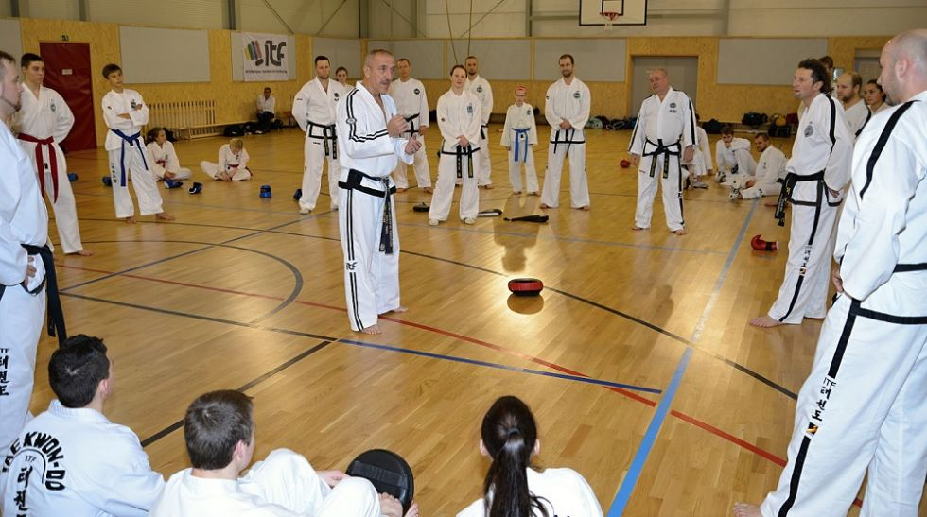
December - 2014
National seminar 2014
The latest part of the seminar was planned for Dan grading. Master provided a short time to warm up and inaugurated a nine contestants for black belt degrees. Dan grading lasted nearly three hours, what indicates how demanding the examination was for all participants. Finally, all candidates successfully passed and we warmly congratulate on their promotion hereby.
After the exams has left only to say “thank you” to all attendees for participation and to organizers for their caring treatment. Representatives of ČNUTschools were finally invited to a gala dinner with master Jedut, where all could discuss learnings and share feelings from the day.
Topics like long term vision of ČNUT and next training strategy were coved also and timing for next seminar has been preliminarily scheduled to Q2-3 2015, exact date to be specified soon.
For January there is also scheduled a regional seminar, where the main new learnings are supposed to be applied to work of the regions and schools.
For the first time this year, together with this event there’s planned also a joint training of wider representation and will commence a preparation for the World Cup, which takes place in May 2015 in Jesolo, Italy.
www.taekwondocz.com NA for ITF & AETF in Czech Republic

Slide 22
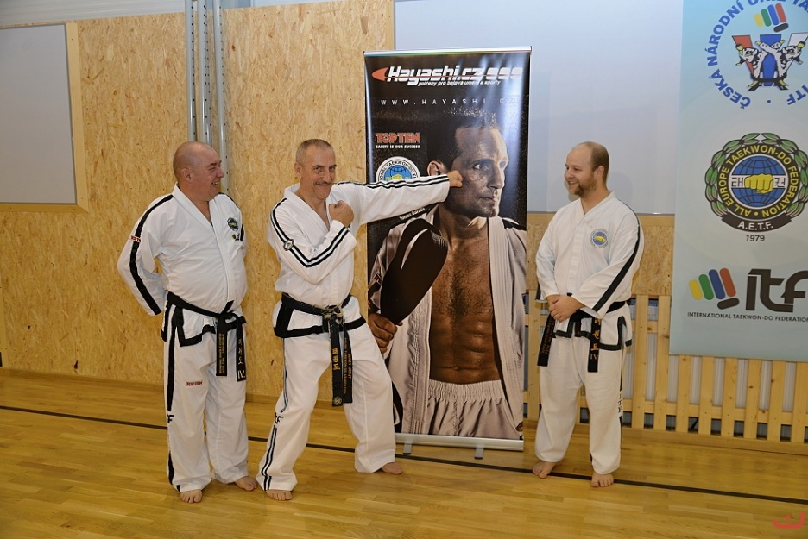
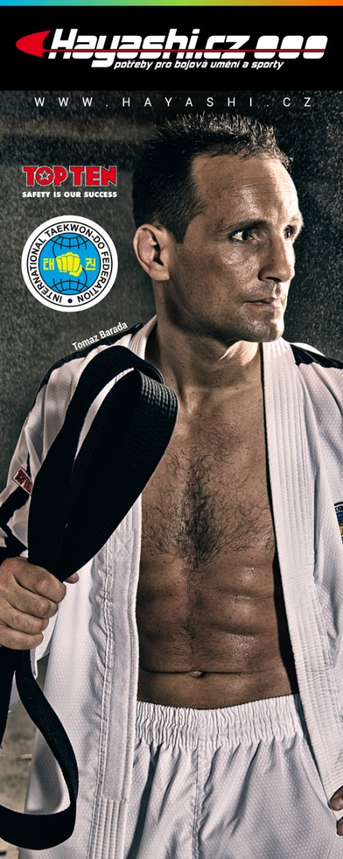
December - 2014
Partnership with representative of TOP TEN brand in Czech Republic
CzNTU entered into partnership with company named Hayashi – supplier of the epuipment of brand TOP TEN.
This company is the biggest local supplier of sport equipment for martial arts in Czech Republic.
The Hayashi company guarantee very good price level for purchase of sport equipment for authorized centres (schools and clubs) of CzNTU.
Each member of our union can take advantage of this contract for purchase of sport equipment they need to study Taekwon-Do as doboks, belts, safety equipment etc.
The Czech National Taekwon-Do Union will present this partner during all events.
The first time, this partnership and the brand TOP TEN were presented during the National seminar of Czech Republic in December 2014.
The Hayashi company will be the general partner of Czech national team at the World Championship in Jesolo, Italy.
www.taekwondocz.com
NA for ITF & AETF in Czech Republic

Slide 23
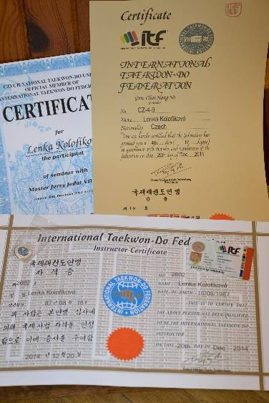
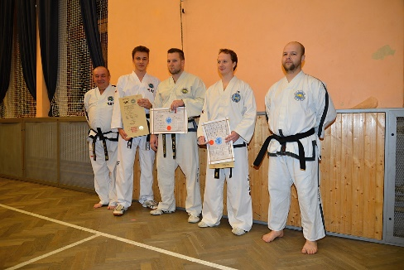
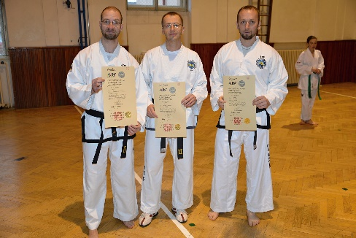

January - 2015
Ceremonial handing over of certificates from Dan grading
New international instructor
During firsts trainings of the year 2015 ceremonial handing over of certificates from Dan grading (December 2014) took place. Promoted were some new Black belts and also few International Instructors.
Members of Board of Directors of CzNTU were participated in this ceremony and also some trainers of CzNTU. Certificates were handed over by president Viktor Stein and chairman of Technical Committee Kamil Kolofík.
The result is that Czech Republic has 3 new International Instructors, in total 9 black belts were promoted.
On this occasion we would like to praise secretariat and technical committee of ITF and CzNTU for their great job – all agenda and certificates were done immediately after the Dan grading and we had certificates and ID cards during Christmas already. Thanks this fact we could hand certificates over after start of new year. Thanks to all for their good work.
Promoted were:
Miss Lucie Bohatá I. Dan
Miss Sára Podskalníková I. Dan
Mr. Pavel Barhoň I. Dan
Mr. Jiří Holan II. Dan
Mr. Jan Růžička III. Dan
Mr. Michal Zemanec III. Dan
International instructor Jaroslav Urbánek IV. Dan
International instructor Tomáš Mácha IV. Dan
International instructor Lenka Kolofíková IV. Dan
www.taekwondocz.com NA for ITF & AETF in Czech Republic

Slide 24

January - 2015
Regional seminar Benátky n/J
and training of National team preparatory
On Sunday 11th January 2015 our Junior team met in Benátky nad Jizerou.
To National team preparatory of CzNTU were invited Patricie Pokorná, Daniela Rychterová, Jakub Roubal, Jakub Zemanec, Lucie Bohatá, Eliška Hupcejová and Tereza Stankeová, more candidates to this team will be added in few next days. Then will be nomination for year 2015 closed.
Competitors will have many common trainings before their premier, which will be Slovak Prešov Open 2015 in March 2015. Black belt holders already do their preparation for World Championship which will be hold in May in italian city Jesolo.
We cross our fingers for all czech competitors to succeed in international competitions.
www.taekwondocz.com NA for ITF & AETF in Czech Republic

Slide 25
January - 2015
Plaques and fees ITF, AETF
On 9th January 2015 member fees for Czech Republic´s NA Czech National Taekwon-Do Union were paid- 50 € for ITF, 100 € AETF and plaques were renewed.
ID | First Last Name | Plaque number
481424 | Lenka Kolofíková | 607664
481430 | Kamil Kolofík | 197
481444 | Tomáš Mácha | 607654
481472 | Viktor Stein | 600979
481480 | Jaroslav Urbánek | 600981
481705 | Petra Bláhová | 607663
503182 | Jan Růžička | 607655
503183 | Ondřej Růžička | 607656
503184 | Michal Zemanec | 607657
503185 | Jiří Holan | 607652
481435 | Josef Kubát | 607653
Meeting CzNTU - new strategy 2015
On Sunday 11th January the Executive committee of CzNTU met with trainers in Benátky nad Jizerou. The programme was about authorization of stragegic and financial plan for season 2015/2016.
On of articles was about organization of Championship of Czech Republic, which will be held 16th May 2015.
The nomination of competitors which can participate in World Championship in italian city Jesolo was authorized.
All leaders of schools and clubs and trainers were informed about advance in partneship, sponsorship and requests for grants filled during last days.
www.taekwondocz.com NA for ITF & AETF in Czech Republic

Slide 26
Czech National Taekwon-Do Union ITF
Strategic Plan for season 2015 - 2016
www.taekwondocz.com NA for ITF & AETF in Czech Republic

Slide 27
The plan of events for season 2015 - 2016
Competitions
Czech Championship – 16th May 2015 Benátky nad Jizerou
Non-competitive events
Demonstrations – promotion of Taekwon-Do
Recruiting new students to our schools
Summer camp - July 2015
For members of CzNTU, one part of this summer camp is that our students demonstrate Taekwon-Do for the public as part of promotion of Taekwon-Do in Czech Republic.
Weekend training camps
Extra trainings – we would like to start with preparation for programme integration ITF Kids.
Courses and seminars
National seminar with master Jedut - October 2015
Trainers and referees course April 2015
Regional seminars
Grading
We are going to hold gradings to Kup and Dan.
Attendance at congress
President of national association Mr. Viktor Stein and Chairman of technical committee Mr. Kamil Kolofík will be attending the congress of ITF in Italy May 2015
www.taekwondocz.com NA for ITF & AETF in Czech Republic

Slide 28
The strategic plan of CzNTU 2015
Organization
1. Update and authorization of CzNTU´s By Laws according to new legislation of Czech Republic – 2/2015
2. Controll and update of internal directives of CzNTU according to new legislation of Czech Republic and strategy of CzNTU – 1st halfyear 2015
3. Continue in doing materials for membert of CzNTU – grading manual was published in 2014,
referee manual – 6/2015
Manual for trainers – year 2016
Finance and marketing
1. Financial plan for 2015 (included budget for competitons, seminars etc.) – 1/2015
2. Control of outlays and resources of CzNTU – 1/2015
3. Promotional video of CzNTU – 9/2015
4. Put the stress for promotion of events and clubs (posters, conmemoratives as pens etc. – cooperation with sponsors) – whole year 2015
5. Preparation of materials for sponsors (what we can offer to them) – 12/2015
6. Periodically fill request for grants from municipals, ministries etc. – fund for National team – 7-8/2015 grant from Ministry of education and sports,
1st quarter 2015 municipals, other grants – need to be controll whole year
Communication
1. Straight communication with members – contacts on website must be valid – whole year 2015
2. Activ using of social nets (mainly Facebook), make own youtube-channel, Google+ – 1st quarter 2015
3. Make business cards for CzNTU´s headquarters – 1st quarter 2015
4. Card with contacts for new members and for recruiting – included times of trainings in schools, contact to trainers, websites etc. - 8/2015
www.taekwondocz.com NA for ITF & AETF in Czech Republic

Slide 29
The strategic plan of CzNTU 2015
5. Information support for trainers – sharing (eg. google+ or Download on website) – 1st quarter 2015
6. Make unified forms for eg. application to competitions, to grading etc. – 1/2015
7. Extend range of visitants of website – crossed links with sponsors – whole year 2015
8. Make press releases to all events in Czech Republic and send them to AETF and ITF to publish – whole year 2015
9. Publish bulletin periodically – whole year 2015
Education and trainings
1. Prepare materials for trainers – recommendations, model trainings – 2016
2. Prepare for enter the ITF kids programme (need to participate seminar – best in Europe) – whole year 2015
3. Focus on teach trainer in various areas (pedagogy, work with children, fyziology, legal system etc.) – 6/2015
4. Make unified test for examine to trainers licences (3rd and 4th level) – 12/2015
5. Support for trainers in additional education (FTVS Prague, faculty in Olomouci etc.) – whole year 2015
6. Organize course for trainers and competitors – 6/2015
7. Organize common trainings only for trainers and assistants – unification of techniques, information from IICs, consultation about leading trainings – whole year 2015
Competitions
1. Organize extra trainings for talented students – whole year 2015
2. Gain funds for talented students - whole year 2015
3. Organize regional, national and open competitions, its presentation on website and in regional press – whole year 2015
4. Make calendar of events – 2/2015 and continuous update
5. Promotion of competitions at AETF and ITF websites – whole year 2015
6. Find out possibilities of holding competitions or annother events of ITF or AETF in Czech Republic – make organization team and budget etc. – whole year 2015
www.taekwondocz.com NA for ITF & AETF in Czech Republic

Slide 30
New adress CzNTU Headquarters offices in Prague Czech republic
Czech National Taekwon-Do Union ITF
Varhulíkové 1582/24
Prague 7 ZIP 17000 Czech Republic
Company nr.: 26635861
Tax ID: CZ26635861
Registration: L 13917 Městský soud Praha
cnut@taekwondocz.com
www.taekwondocz.com
You Tube
Facebook
Google+
Viktor Stein
President
president@taekwondocz.com
Kamil Kolofík
Technical kommittee
technical@taekwondocz.com
Monika Dobíhalová
Secretary
sekretar@taekwondocz.com
www.taekwondocz.com
NA for ITF & AETF in Czech Republic

